Slide 1
Design, Simulation, and Analysis of AM and FM Communication Systems
By: Justin Pulley

Slide 2
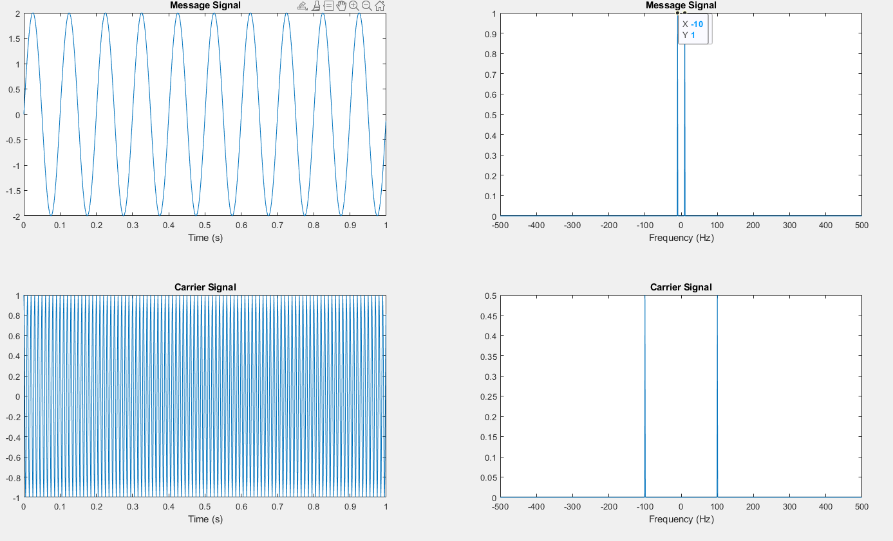
Message and Carrier Signal (AM)
m(t) = A_{m}sin(w_{m}t)
A_{m} Amplitude of Message Signal = 2
⍵_{m} frequency of message signal = 2𝝅f_{m} rad/s
f_{m} frequency of message signal = 10 Hz

Slide 3
Message and Carrier Signal (AM)
c(t) = A_{c}sin(w_{c}t)
A_{c} Amplitude of Message Signal = 1
⍵_{c} frequency of message signal = 2𝝅f_{c} rad/s
f_{c} frequency of carrier signal = 100 Hz

Slide 4
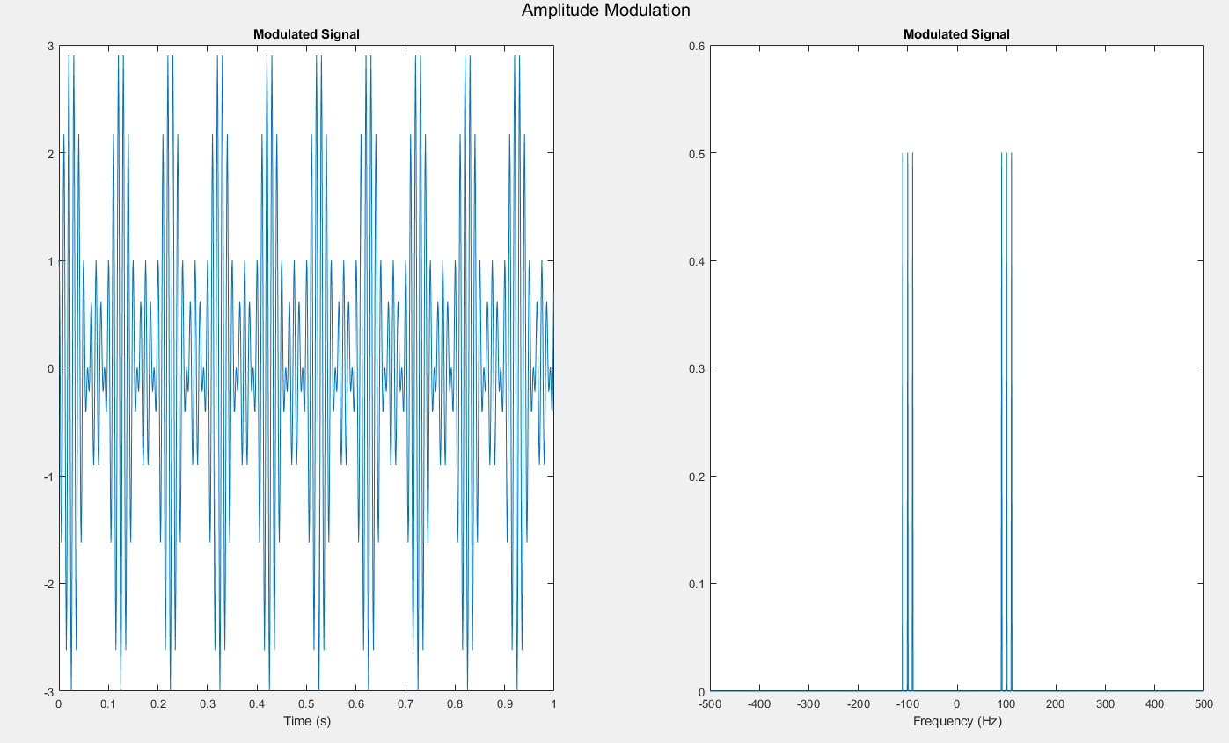
AM Modulation
= A_{c}*(1+ 𝜇*m(t))*c(t)
A_{c} gain of carrier = 1
𝜇 modulation index = 1
m(t) message signal
c(t) carrier signal

Slide 5
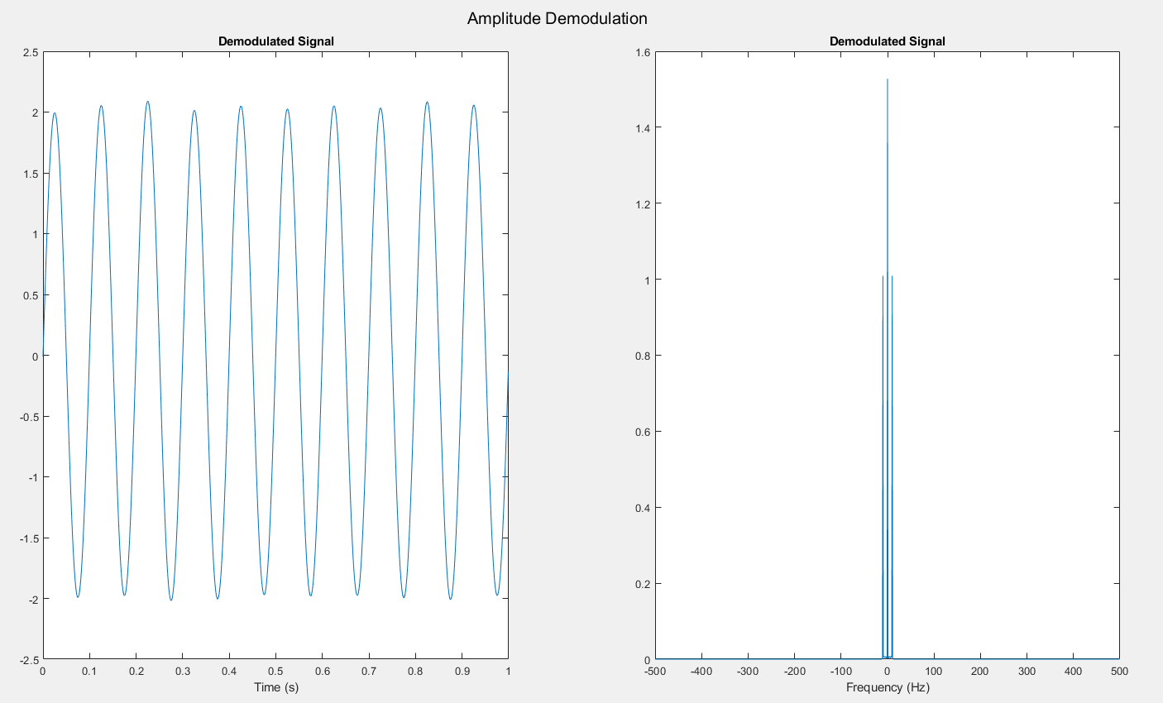

AM Demodulation (Squaring Technique)
= 𝐴_{c}²(1+𝜇𝑚(𝑡))² cos²(2𝜋𝑓𝑡)

Slide 6
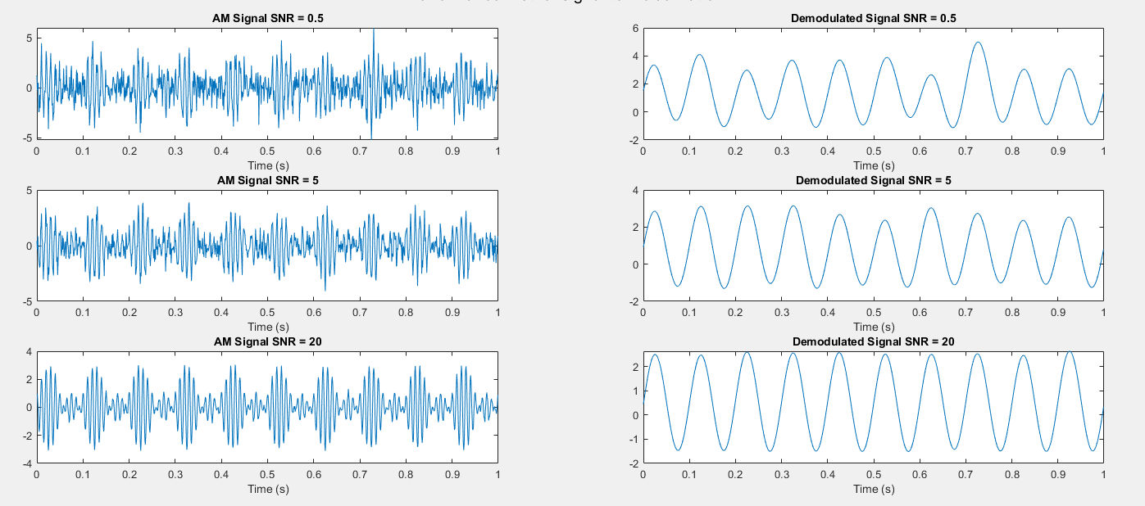
AM Noise Analysis
Added Additive White Gaussian noise at varying SNRs
The higher the SNR, the better the demodulated signal

Slide 7
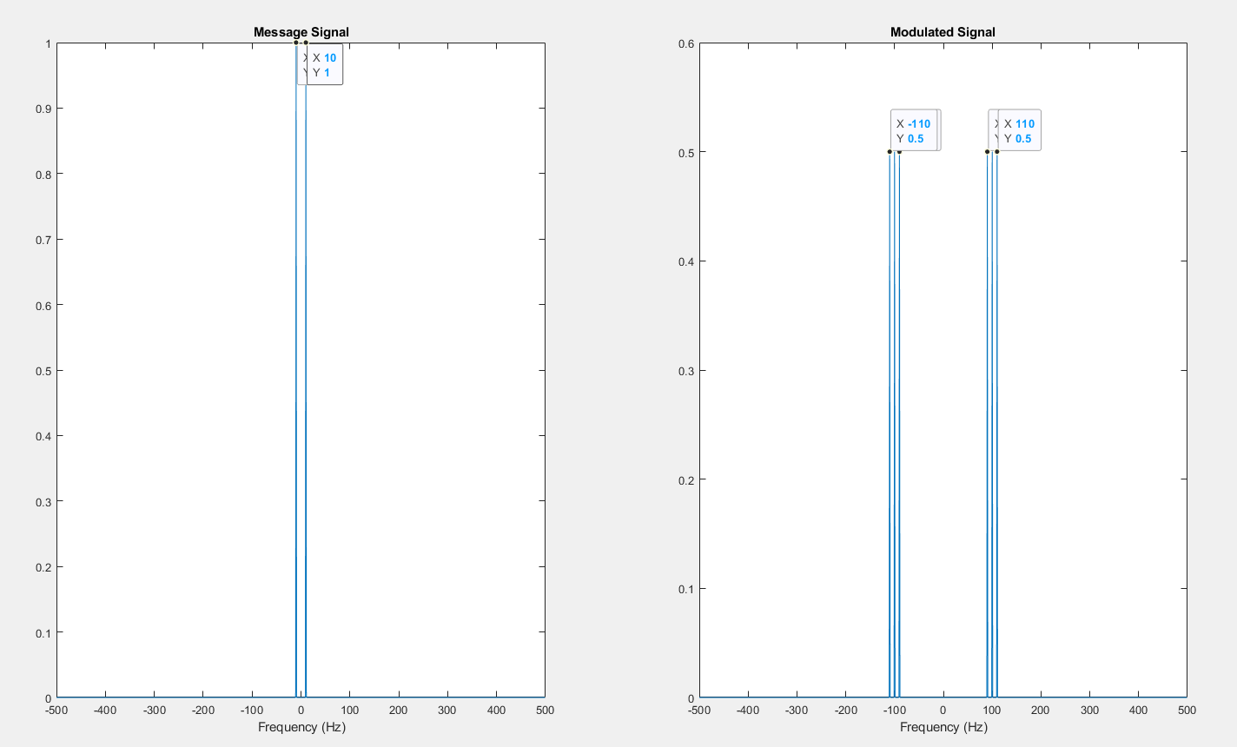
AM Bandwidth Analysis (B = 20 Hz)

Slide 8
Power of AM Signal
P_{c} (power of carrier signal) = A_{c}²/2 = ½
P_{f} (total power of AM signal) = P_{c}(1+(𝜇²/2)) = ¾

Slide 9
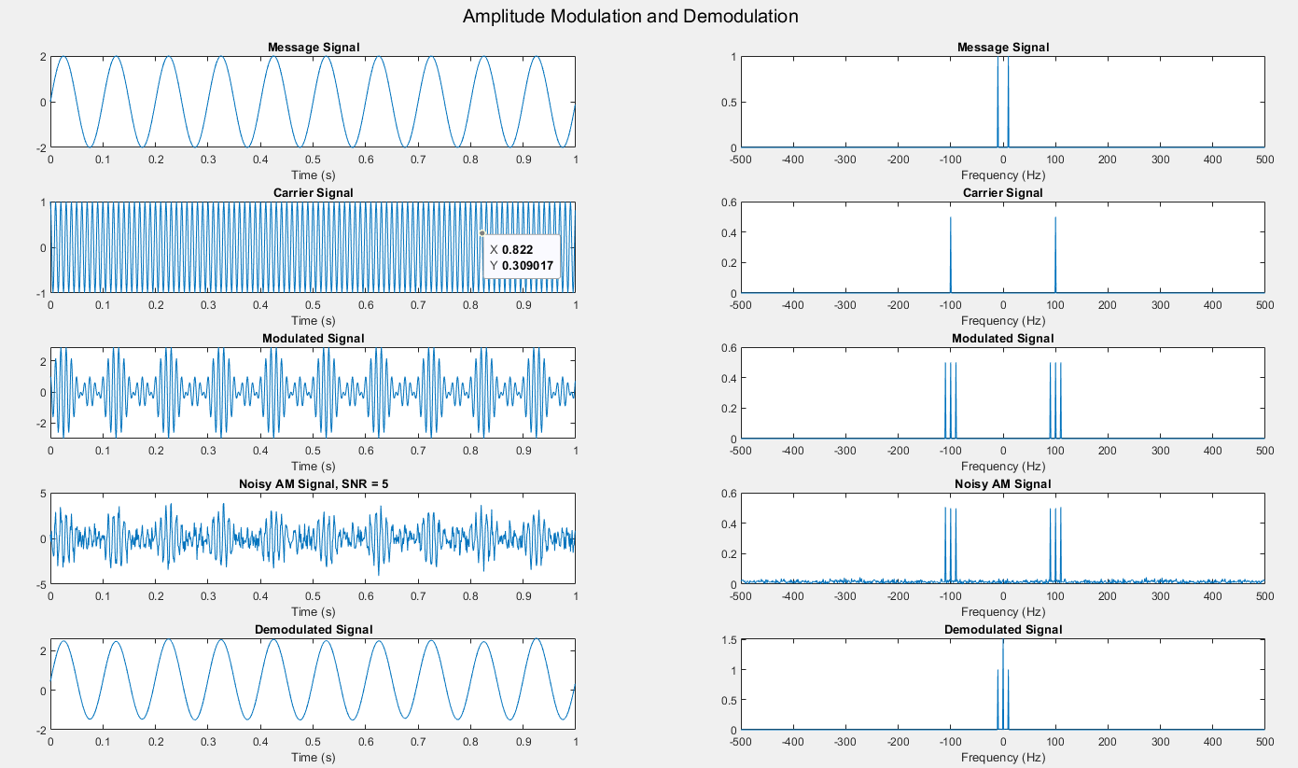
AM Overview

Slide 10
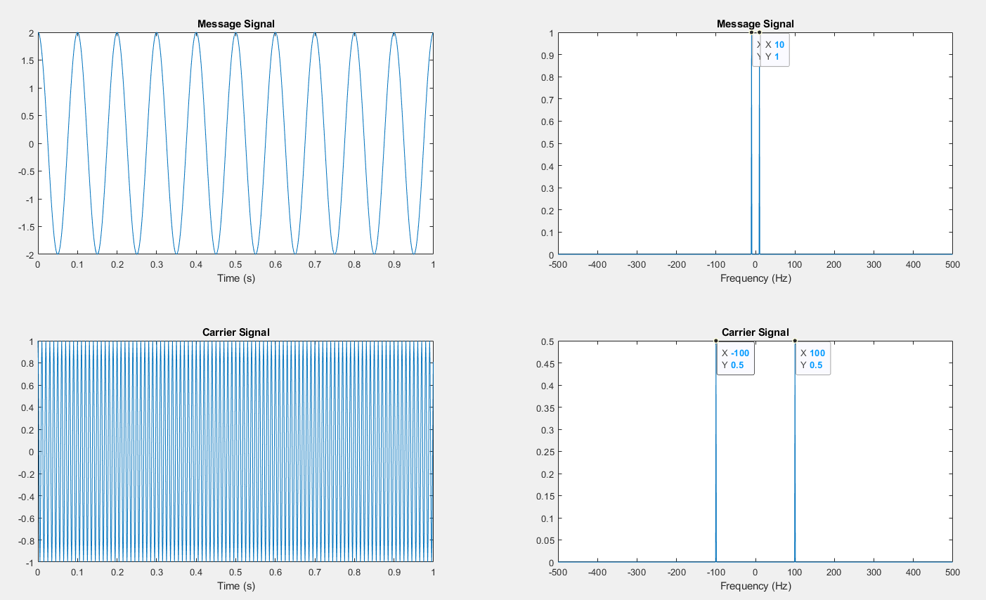
Message and Carrier Signal (FM)
m(t) = A_{m}cos(w_{m}t)
A_{m} Amplitude of Message Signal = 2
⍵_{m} frequency of message signal = 2𝝅f_{m} rad/s
f_{m} frequency of message signal = 10 Hz

Slide 11
Message and Carrier Signal (FM)
c(t) = A_{c}cos(w_{c}t)
A_{c} Amplitude of Message Signal = 1
⍵_{c} frequency of message signal = 2𝝅f_{c} rad/s
f_{c} frequency of carrier signal = 100 Hz

Slide 12
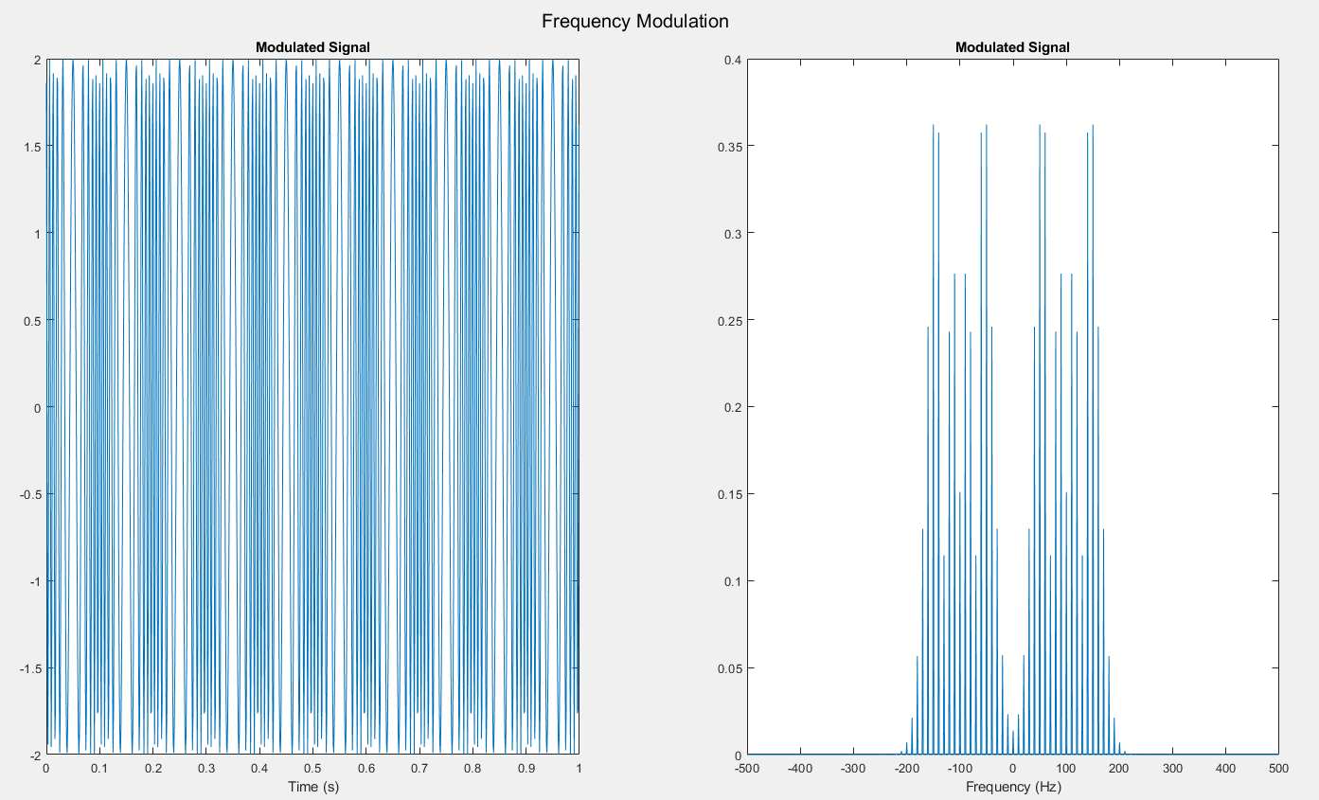
FM Modulation
= A_{c}cos(w_{c}t + (k_{f} ₀∫^{t}(m(τ)*dτ))
A_{c} (gain of carrier) = 1
k_{f} = 2𝝅 x 30
m(t) message signal

Slide 13
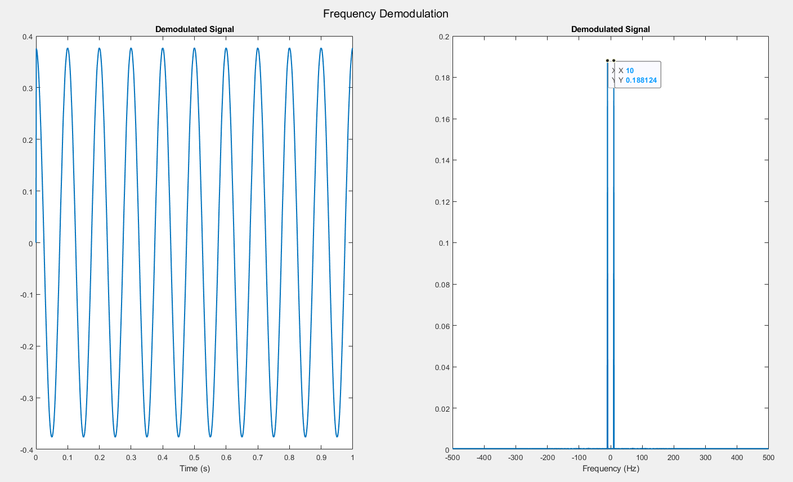
FM Demodulation
Demodulates the FM waveform by modulating the Hilbert transform of the signal by a complex exponential of frequency -fc Hz and obtains the instantaneous frequency of the result.

Slide 14
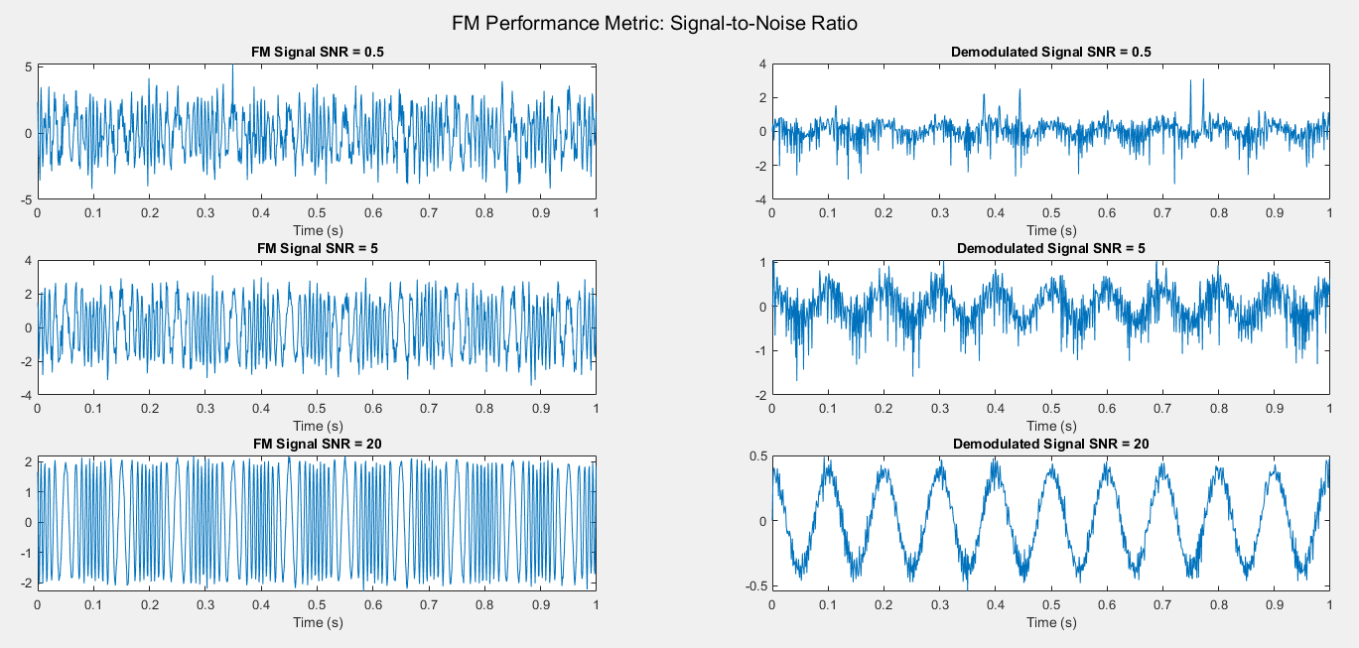
FM Noise Analysis
Added Additive White Gaussian noise at varying SNRs.
The higher the SNR, the better the demodulated signal.

Slide 15
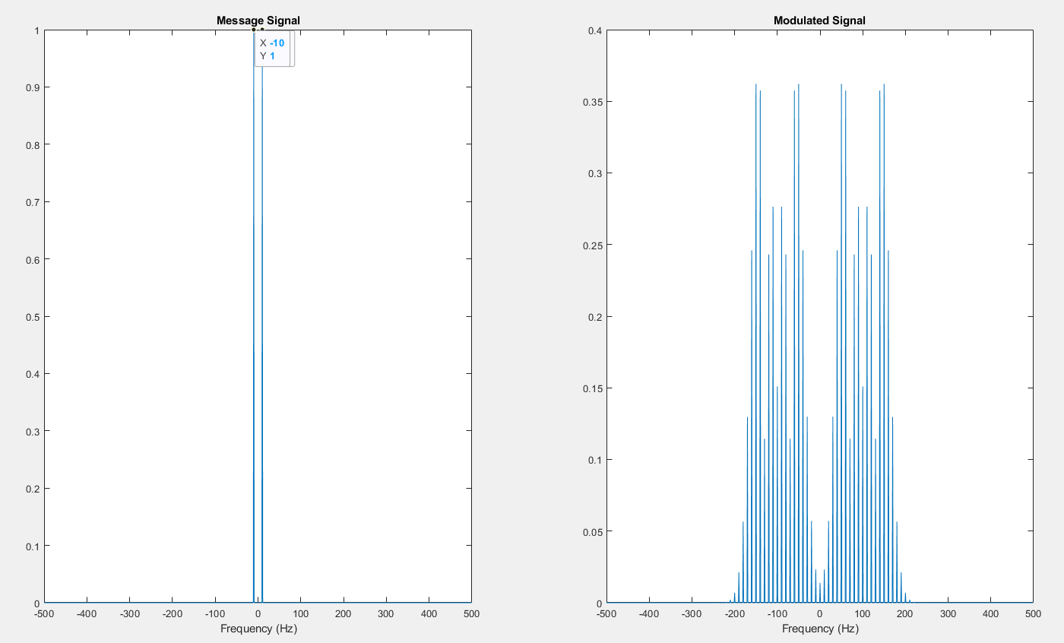
FM Bandwidth Analysis (B = 200 Hz)

Slide 16
Power of FM Signal
FM does not affect the power of a signal, so the FM signal has the same power as the message signal.
B = A_{c}²/2 = 2 watts

Slide 17
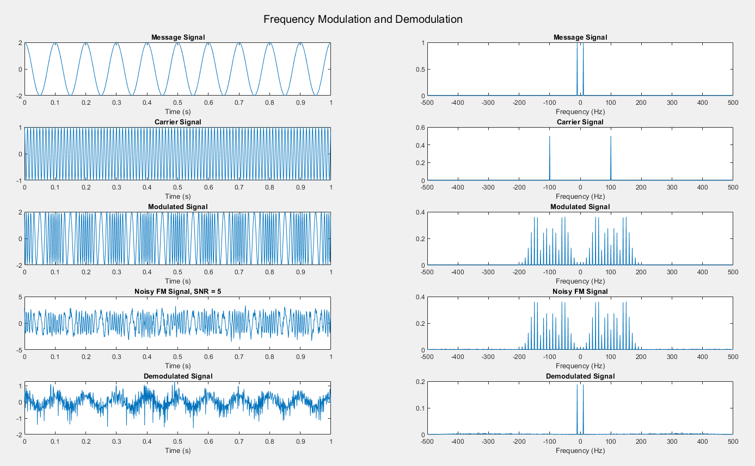
FM Overview

Slide 18
AM vs. FM
FM signals use more bandwidth than AM signals.
Typically, FM signals are more resistant, but the results from my experiment shows that AM signals are more resistant.

Slide 19
Questions?

